Slide 1
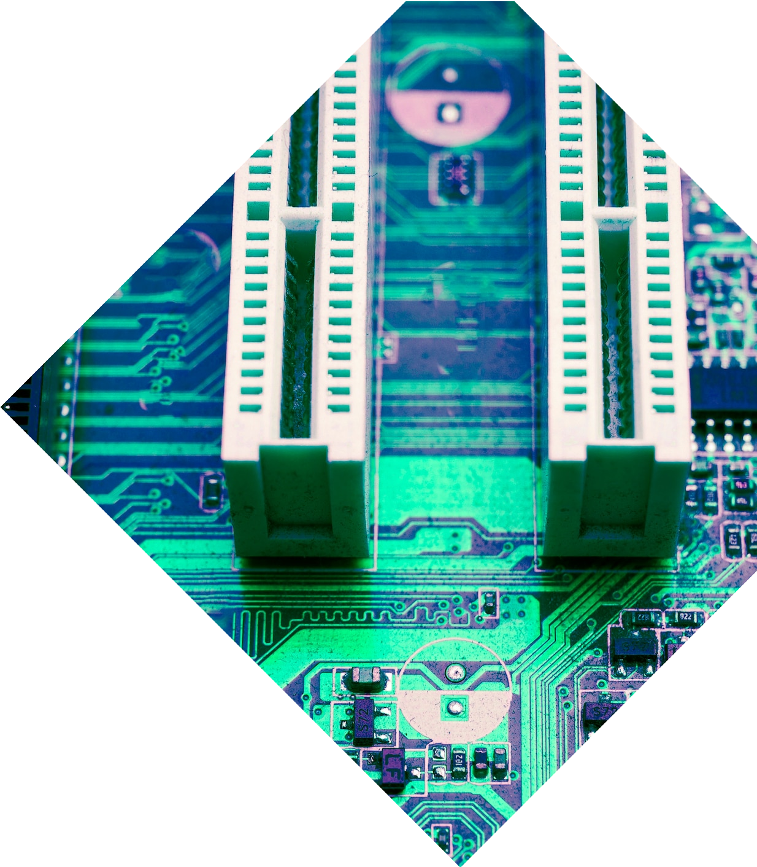
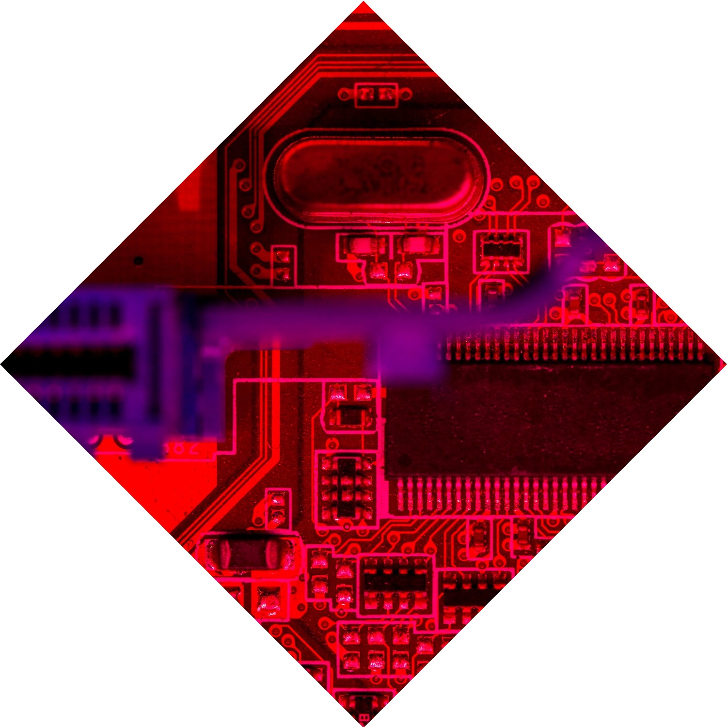
Efficient Exhaust Fan Control with ESP32 Chip and I2C LCD Meter in Manufacturing Facilities

Slide 2


Introduction
In this presentation, we will explore how chip and I2C LCD Meter can
efficiently control exhaust fans in
manufacturing facilities, optimizing energy
usage and improving air quality. We will also discuss the benefits of this technology for cost savings and environmental impact.

Slide 3


Challenges in Manufacturing Facilities
Manufacturing facilities often face challenges in control, leading to energy wastage and poor air quality. Manual control systems can be inefficient and costly. The use of ESP32 chip and I2C LCD Meter offers a solution to these challenges, providing automated and precise
control.

Slide 4

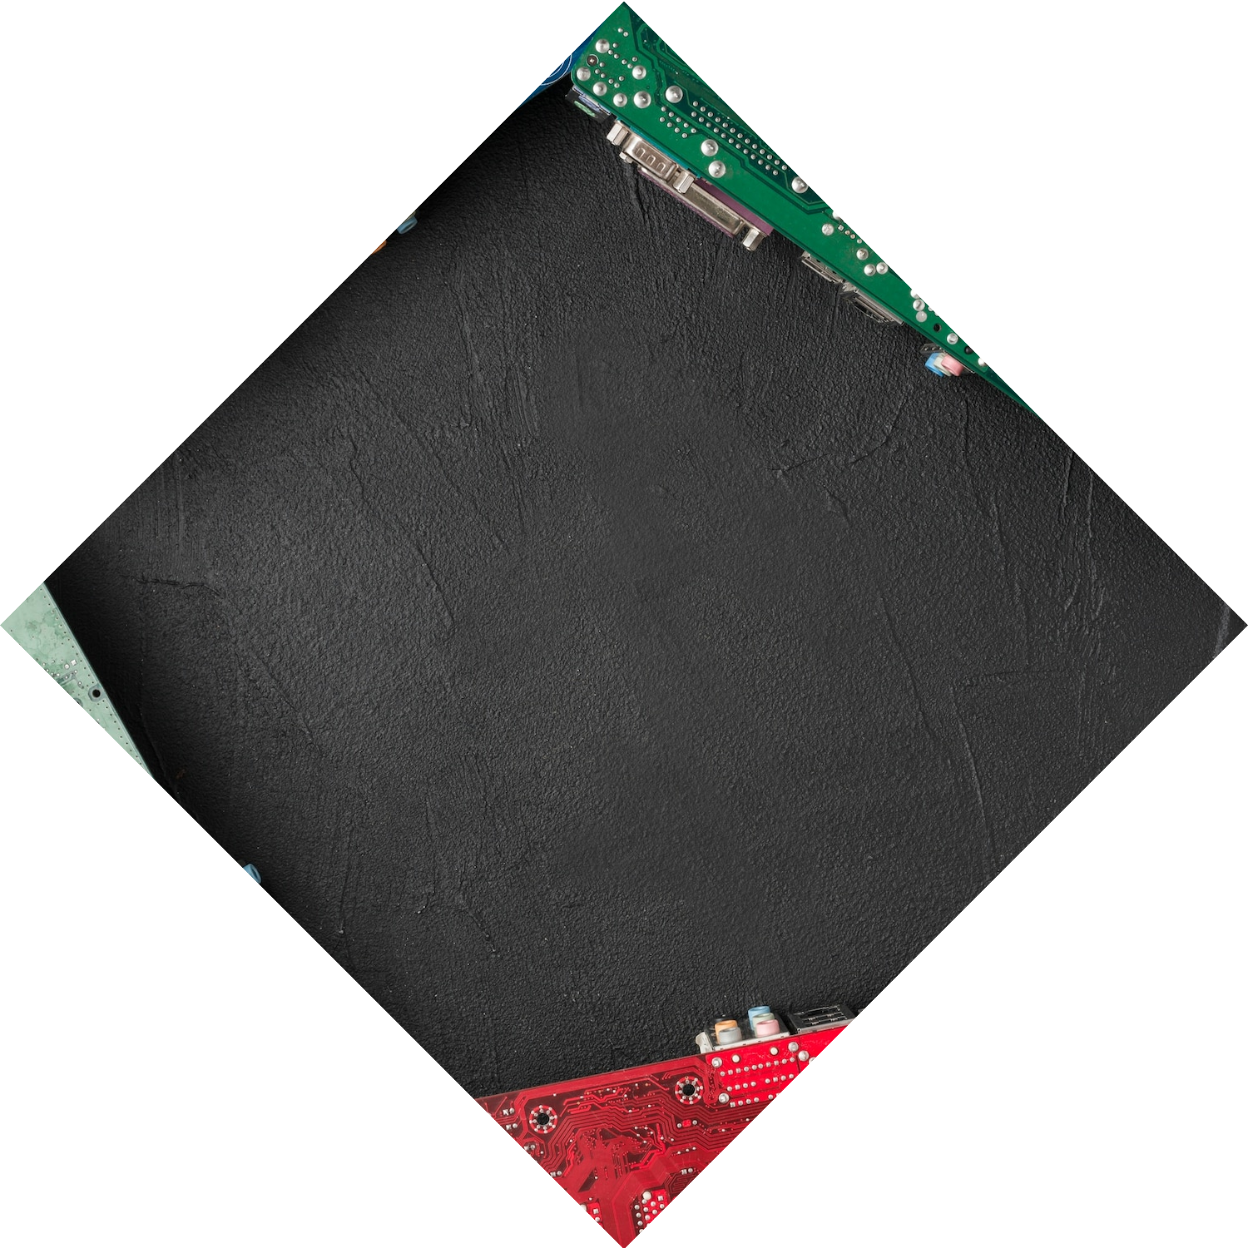
ESP32 Chip Technology
chip is a powerful and versatile microcontroller that offers WiFi and Bluetooth connectivity, making it ideal for IoT applications. Its low power consumption and high processing capabilities make it a suitable choice for exhaust fan control in manufacturing facilities.

Slide 5
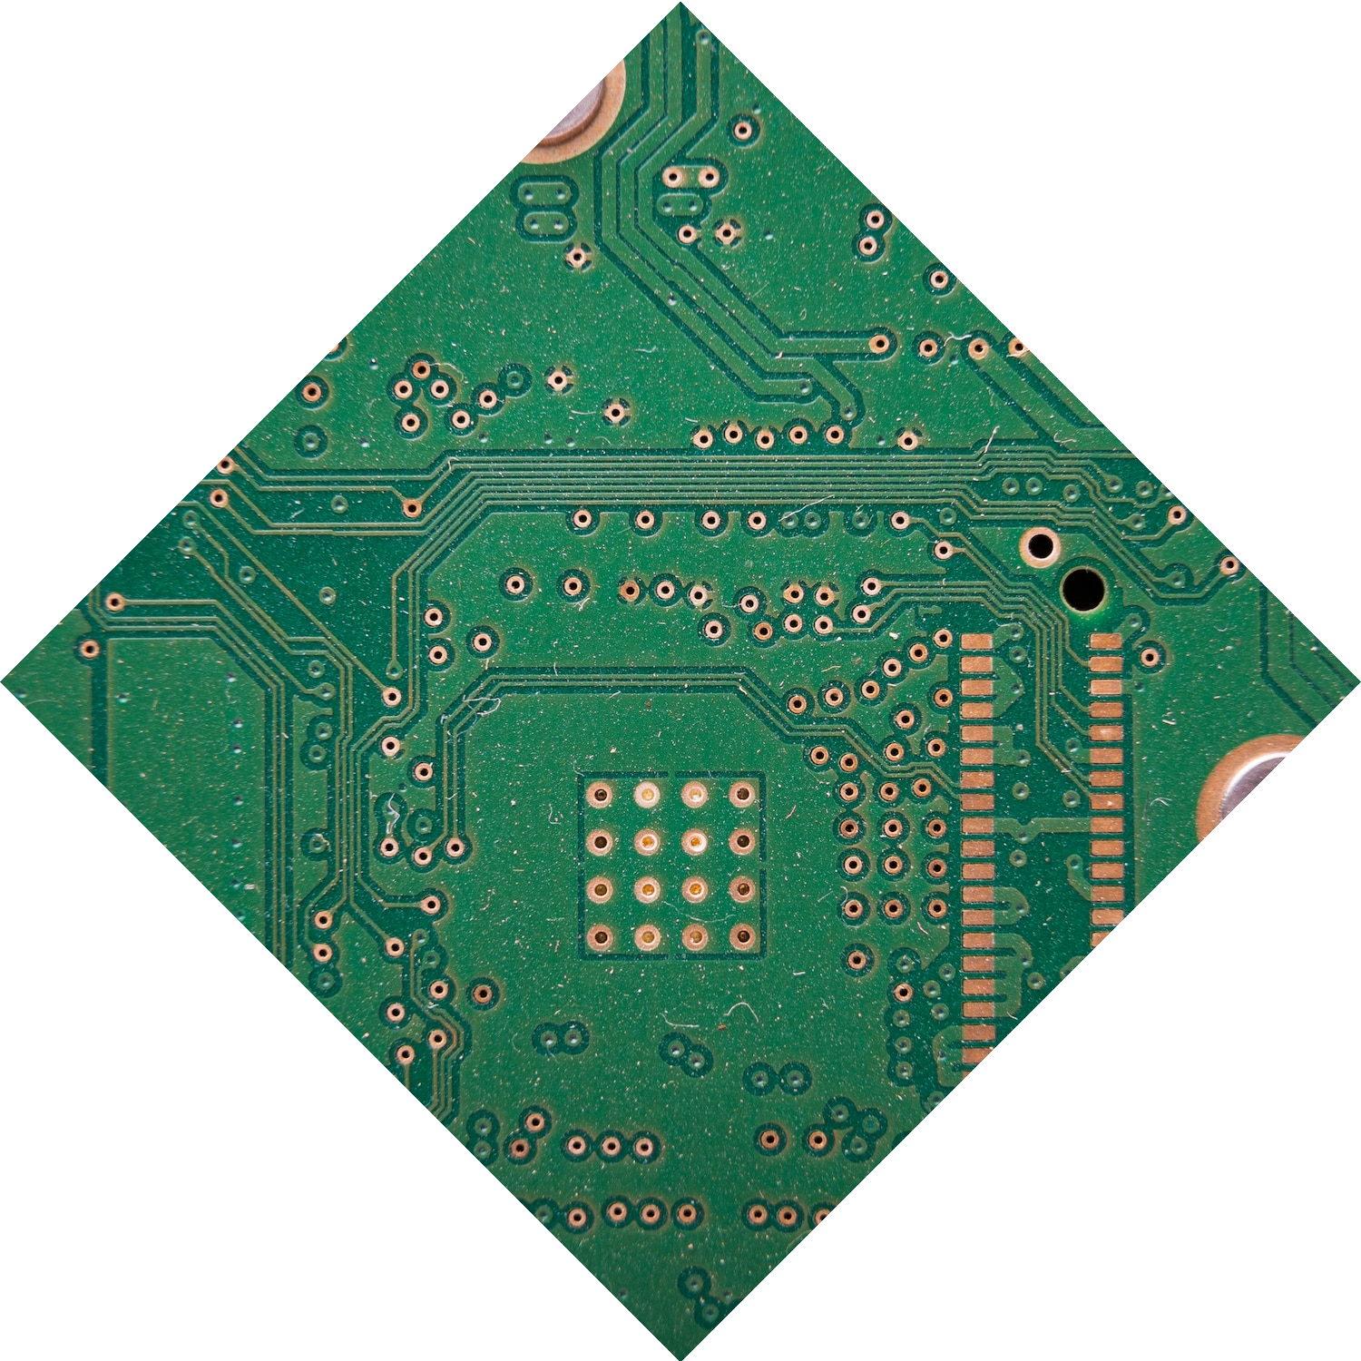
I2C LCD Meter Integration
I2C LCD Meter provides a convenient and user-friendly interface for monitoring and controlling exhaust fan operation. Its compatibility with the ESP32 chip allows for seamless integration, enabling real-time data display and precise adjustments to fan speed and operation.

Slide 6
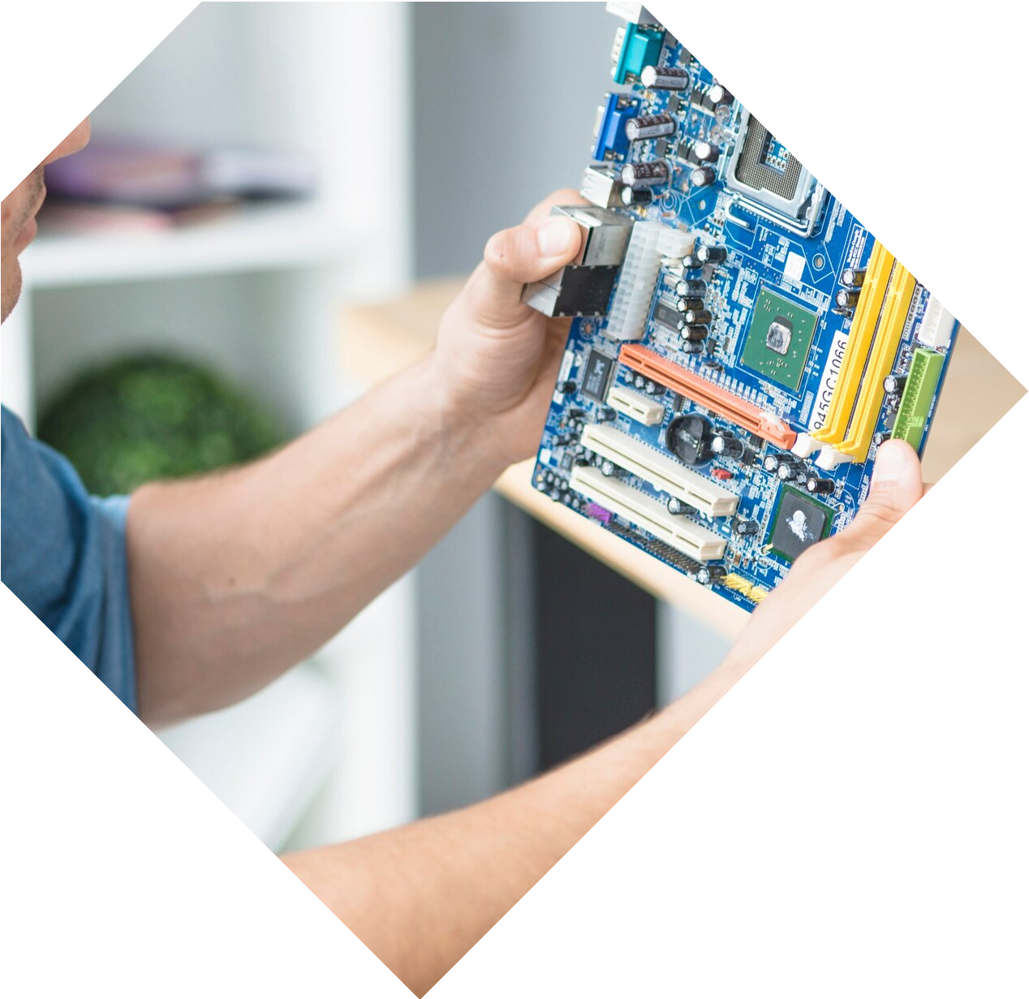


Benefits of Efficient Exhaust Fan Control
Efficient exhaust fan control with
chip and I2C LCD Meter offers numerous benefits, including reduced energy consumption, improved air quality, cost
savings, and enhanced environmental sustainability. This technology empowers manufacturing facilities to optimize their operations.

Slide 7

Conclusion
The integration of
chip and I2C LCD Meter
presents a compelling solution for efficient exhaust fan control in manufacturing facilities.
By leveraging the capabilities of these technologies, facilities can achieve significant
improvements in energy efficiency, air quality, and overall operational performance.

Slide 8
Thanks!

